Slide 1

Behavioural Insights and Experimentation in Government
Jenelle Power & Justine Baron
Service Insights and Experimentation (SIX), Client Experience Branch
Immigration, Refugees, and Citizenship Canada
May 2, 2019

Slide 2
Learning objectives
This presentation will give you the answers to the following questions:
What is behavioural insights and experimentation?
Why are behavioural insights and experimentation valuable?
How can you apply behavioural insights and experimentation in the government context?

Slide 3
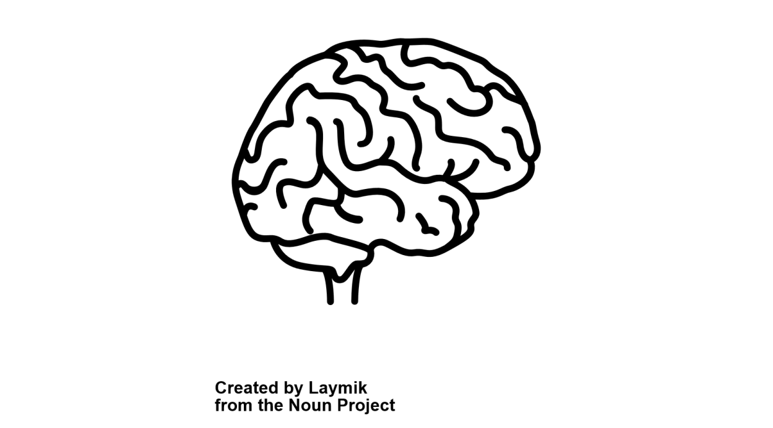
Behavioural Insights (BI)
Behavioural sciences (such as psychology, behavioural economics, and marketing) provide insights on how people make decisions and engage in various behaviours
Our programs and services work
best when they are designed with
the people who use them in mind
Behavioural Insights
Psychology
Behavioural economics
Marketing
Cognitive science

Slide 4

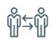



Behavioural Insights (BI)
Based on what we know on how humans think, make decisions, and behave
Examples:
Social norms
Converts
Incentives and rewards
Loss aversion
Cognitive dissonance/self-perception

Slide 5
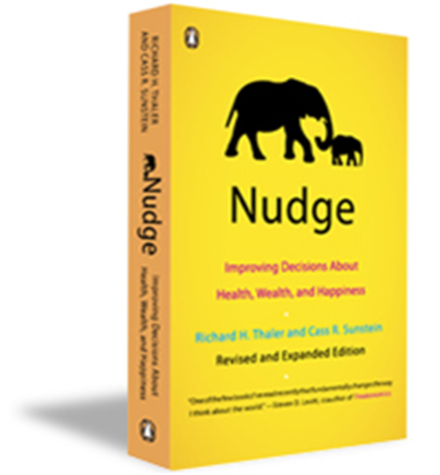
What is a “nudge”?
A light touch intervention
Designed to help individuals make positive changes to their behaviour
Does not forbid any options or significantly change their economic incentives

Slide 6

Nudging
A nudge:
needs to be designed based on good understanding of clients’ experiences
works best when we rigorously test a number of options, and develop them through iterative experimentation
is like a GPS – it tells you where to go but it doesn’t force you to go there
is not a silver bullet, and is often just “one link in the chain” to improved outcomes

Slide 7
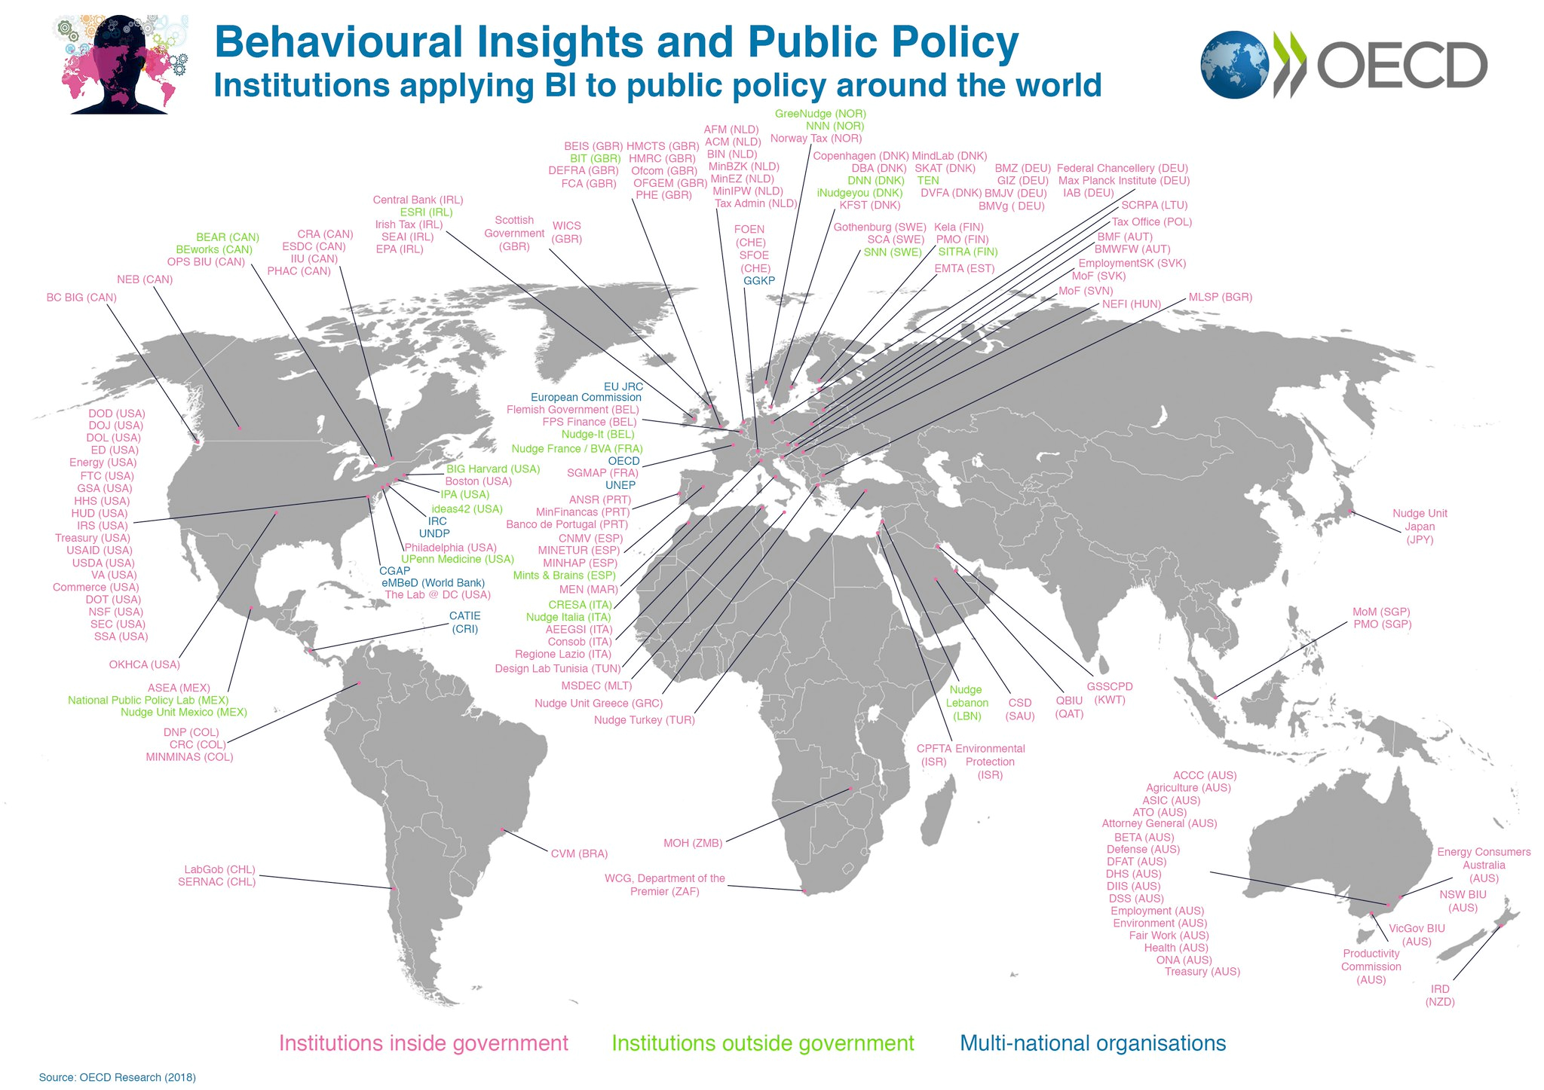

Slide 8





Examples of digital nudges
A personalized email that reminds someone to complete an enrollment form
A text from a team member to the rest of the group that shares progress on the work goals met that week and nudges the recipients to meet their goals
An activity monitor (e.g., fitbit) that reminds the user to exercise, gives feedback on activity, presents friends’ statistics (social norms)
E-finance: setting defaults for frequently selected insurance plan options
Security and privacy: displaying feedback on the strength of selected passwords

Slide 9
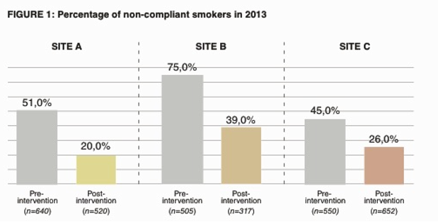

Nudges
Decreasing smoking rates outside the smoking area in Copenhagen Airport

Slide 10

Examples of Nudges
Encouraging healthier beverage choices
at Alfred Health Hospital (Australia) by using
a colour coding beverages at point of
purchase.

Slide 11

What is experimentation?
Activities which seek to explore, test, and compare the effects and impacts (i.e. what works) of policies, interventions, and approaches to inform evidence-based decision making

Slide 12
Experimentation in the Government of Canada
2016 Experimentation direction for Deputy Heads produced by TBS and PCO makes an explicit link between experimentation and evidence-based policy-making, results, and delivery (see Annex A)
Requirements
Identify a percentage of program funds to devote to experimentation. | Use ethical and rigorous experimentation methods to test program options and to strengthen the evidence base on what works and to use this evidence to course-correct and inform decision-making. | To share the results of experiments, whether they are positive, negative, or neutral/null as broadly as possible, and with a strong default to public release. | To report on performance information related to experimentation in Departmental Plans and Departmental Results Reports.

Slide 13

Why do we need experimentation?
We learn
We fail (in a positive way, i.e. de-risking)
We save money
We have better products, services, and policies

Slide 14
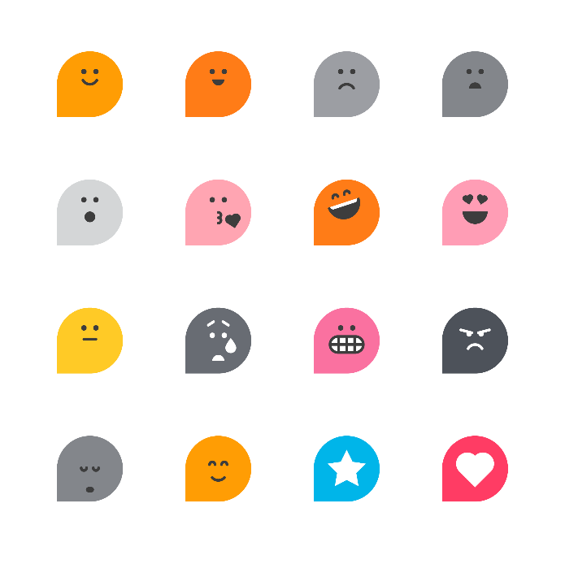

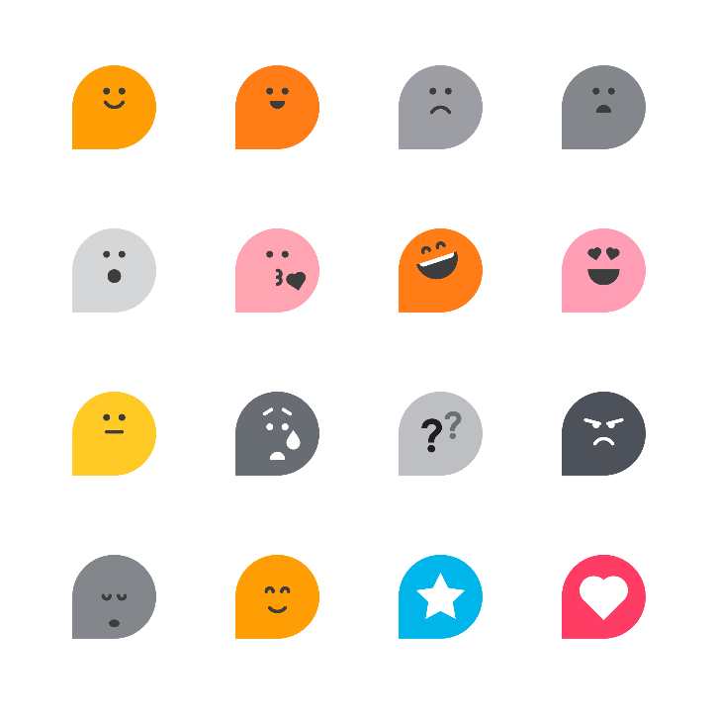
The experimentation project journey
Know how it feels
Analysis and discovery
Bumps along the road
Implementation
Set up trial, engage stakeholders, plan data collection
Excitement, relief, and pride
Designing intervention and research question
Performance
Panic, disbelief, pride, and impatience
Decision to experiment using early idea
Frustration and discouragement, mixed with determination and optimism
Anxiety and confusion, mixed with moments of clarity and satisfaction
Hope and
excitement
Time

Slide 15



Example in IRCC
Increasing uptake to the annual client satisfaction survey
Comparing effects of three email invitation messages against business as usual invitation on open rates, click through rates, and survey completion rates
Simplified invitation + a survey question link
Simplified invitation
Random assignment
Simplified invitation + ‘winner’ type message
WINNER!
Business as usual invitation

Slide 16
Step 1: Define Outcome
Identify the specific behaviour that you are trying to change or the specific choice that you are encouraging (or not encouraging) people to make
Ask yourself:
Why are you running this experiment?
What do you expect will happen?
S.M.A.R.T.
See Annex B for M.I.S.T framework
CLEAR OBJECTIVE + HYPOTHESIS
+
!

Slide 17
Step 2: Diagnose Behavioural Barriers
What is the current state of affairs?
What are the barriers?
May need to conduct exploratory work

Slide 18
Step 3: Identify Interventions
Identify the interventions (‘nudges’) that will help to reduce or eliminate the barriers
Brainstorm alternative options with potential to improve outcomes
Narrow down the option(s) you want to test in an experiment

Slide 19
Step 4: Design Intervention(s)
Consider existing touchpoints
Plan to use administrative data and/or to collect new data
Specify the population on which research is to be conducted
Consider target sample size (to ensure sufficient power)
Select a research design and prioritize use of a counterfactual (‘control group’)
Verify availability of necessary resources
Build partnerships

Slide 20
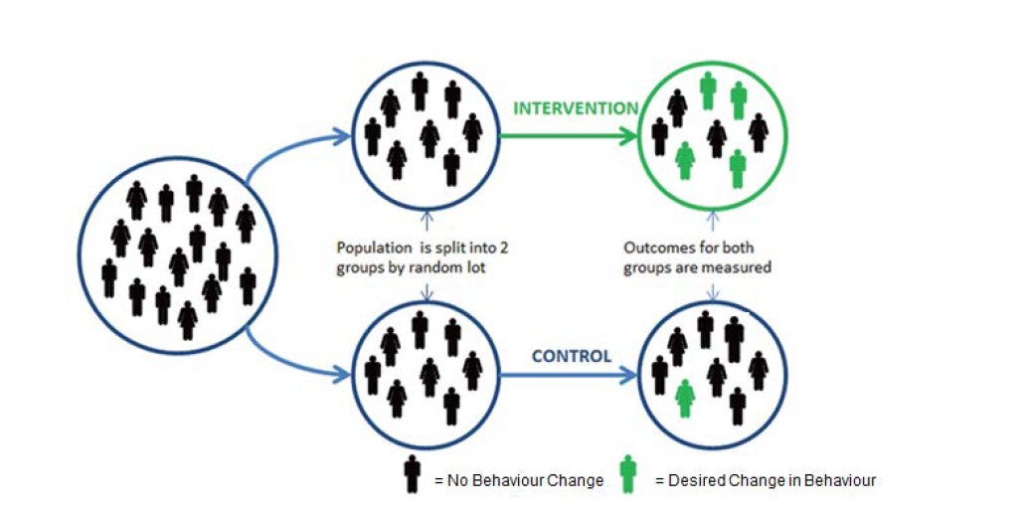
The Gold Standard RCT
= No change observed
= Desired change observed

Slide 21
Step 5: Test Intervention(s)
Begin implementation phase
Monitor and record changes made to the intervention tested
Congratulations! You just ran an experiment.

Slide 22
Step 6: Analyze Results & Scale Up
Analyze data
Draft report on methods, findings, and recommendations
Consider if further iterations make sense
Determine next steps

Slide 23
Let’s try it out!

Slide 24
Key Take-Away Messages
Behavioural Insights and experimentation can be powerful tools for understanding clients’ experiences and behaviours, and designing more effective interventions
Client-centered
Evidence-based
Cost-effective
Testing is key to understanding what works and what does not
Being open to failure is a necessary part of the process
The effectiveness of the experimentation system (i.e. its ability to consistently and reliably develop to achieve the goals and priorities of the government) depends on collective effort, involving action from different actors at the individual, organizational, and system levels
Think about ways you can use experimentation in your work
Annex C and D for more info

Slide 25
Questions?
Jenelle Power Justine Baron jenelle.power@cic.gc.ca justin.baron@cic.gc.ca

Slide 26
Annex A. Experimentation maturity model
Mindset | Organization
Embracing Failure | Governance & Incentives
Questioning Assumptions | Dedicated Resources
Informed Action | Building Capabilities
 | Horizontality & Collaboration
Producing Evidence | Mobilization of Evidence
Exploration & Methodology | Dissemination of Results
Ethics & Evidence Integrity | Evidence-Informed Recommendations
Data & Evidence Management | Process Improvement
Evidence Analysis
MATURITY LEVELS
1
Initial Little to no presence
2
Developing Emerging practices
3
Established
Established & successful
4
Excelling
Exceptional & proactive
5
Leader World leader
ENABLING ENVIRONMENT
EXPERIMENTATION

Slide 27




Annex B. Identifying opportunities for Behavioural Insights and experimentation
M
I
S
T
Measurable
Important
Sizeable
Touchpoints
Is the behaviour observable?
Is the behaviour already recorded as administrative data or could be recorded easily?
Does the desired behaviour change have consequential policy implications?
What evidence exists that this behaviour change would be important?
Is there a sufficient sample size to conduct statistical analyses (usually thousands of individuals)?
Is there an existing or low-cost opportunity to deliver an intervention to the focal population?
Source: Ontario Behavioural Insights Unit (2018). Targeting MIST Behaviour Change Opportunities.

Slide 28
Annex C. Examples of projects in the GC
NRCan: Energy label experimentation using Carrot rewards
Health Canada: PRODigy – Improving customer incidence reporting. ESDC.
ESDC: Canada Learning Bond.
Statistics Canada: Increasing response rates to a Statistics Canada survey.

Slide 29
Annex D. Additional Resources
Behavioural Insights Playbook for Channel Shift
EAST: Four Simple Ways to Apply Behavioural Insights
La stratégie comportementale en survol: Aperçu de l’introspection comportementale
Towards an experimental culture in government: reflections on and from practice.
Better public services through experimental government.
Test, Learn, Adapt: Developing Public Policy with Randomised Controlled Trials
Promoting experimentation in government – learning from Canada’s experience.
Experimentation Directive to Deputy Heads.
What works? Evidence for decision-makers.
Fears and assumptions.
How Experiments craft better policy: inside the World’s What Works teams.
Experimental innovation and growth policy: Why do we need it?

